Slide 1
REST APIs
A complete guide to understanding, designing and using REST APIs
6
5
20+
REST Constraints
HTTP Methods
Status Codes
Knowledge Sharing Session · 2026

Slide 2
Agenda
What we'll cover today
What is an API?
JSON — The Data Format
01
07
What is REST?
Request & Response Anatomy
02
08
6 Core Principles
Authentication & Security
03
09
Resources & URI Design
Best Practices
04
10
HTTP Methods (CRUD)
Real-World APIs
05
11
HTTP Status Codes
Tools & Live Demo
06
12

Slide 3
What is an API?
Application Programming Interface
API — A set of rules and protocols that allows different software applications to communicate with each other. It defines how requests and responses should be made, what data formats to use, and what operations are available.
The Restaurant Analogy
👤
→
📋
→
🍳
→
🍕
You
(Client)
Waiter
(API)
Kitchen
(Server)
Food
(Response)
Why Do We Need APIs?
🔗 Integration
🧱 Abstraction
🔄 Reusability
🌍 Ubiquity
Connects different systems, platforms, languages
Hides backend complexity from consumers
One API used by web, mobile, IoT, partners
Powers Zomato, GPay, Instagram, Uber, etc.

Slide 4
What is REST?
Representational State Transfer
REST is a set of rules (or guidelines) for building web APIs.
It was introduced by Roy Fielding in his PhD dissertation at UC Irvine in 2000.
REST vs SOAP
Feature | SOAP | REST
Data Format | XML only | JSON, XML, etc.
Protocol | SOAP over HTTP | Standard HTTP
Complexity | High | Low
Performance | Slower | Faster
Flexibility | Rigid | Highly flexible
Learning Curve | Steep | Gentle
State | Stateful | Stateless
Not a protocol — It is a set of design rules for creating APIs.
REST APIs communicate using HTTP methods like GET, POST, PUT, PATCH, and DELETE.
Web services following REST are called RESTful APIs
Resources are identified by URIs and manipulated via HTTP methods
Designed for scalability, simplicity, and independence

Slide 5
6 Core Principles of REST
The architectural constraints that define a RESTful system
1
🖥️ Client–Server
2
📦 Stateless
3
💾 Cacheable
Strict separation between UI (client) and data/logic (server). Each evolves independently. The client doesn't need to know how data is stored; the server doesn't need to know how it's displayed.
No client session is stored on the server. Every single request must contain ALL information needed for the server to understand and process it. Session state lives entirely on the client side.
Responses must declare whether they can be cached or not. Clients (and proxies) can reuse cached responses to avoid redundant network calls, improving performance and reducing server load.
4
🔗 Uniform Interface
5
🏗️ Layered System
Every REST API follows the same pattern: use a unique URL for a resource and standard HTTP methods (GET, POST, PUT, DELETE) to perform actions. This makes APIs easy to understand and maintain.
Clients can't tell if they're connected directly to the server or through proxy/load-balancer/CDN layers. Intermediaries can handle caching, security, and load-balancing transparently.

Slide 6
Resources & URI Design
URIs identify WHAT — HTTP methods say WHAT TO DO
Resource
URI
Endpoint
Any entity you want to access through API: a user, order, product, document, image. Resources are NOUNS.
Uniform Resource Identifier — the unique address/path of a resource on the server.
The combination of an HTTP method + URI. e.g. GET /users is one endpoint.
URI Design Rules
Rule
✅ Do This
❌ Not This
Use nouns, not verbs
/users
/getUsers
Use plural for collections
/orders
/order
Lowercase only
/products
/Products
Hyphens, not underscores
/user-profiles
/user_profiles
No verbs in URI
DELETE /orders/99
/deleteOrder/99
Use query for filtering
/products?cat=tech
/getProductByCategory

Slide 7
HTTP Methods (CRUD)
Defining actions on resources
GET
Read
Retrieve one or many resources. Should have NO side effects — safe to call repeatedly. Responses may be cached.
GET /users → list all
GET /users/5 → single user
GET /users/5/posts → nested
POST
Create
Create a new resource. Request body contains the new resource data. Returns 201 Created with the new resource.
POST /users
Body: {"name":"Alice",
"role":"admin"}
PUT
Update (Full)
Full replacement of a resource. You MUST send ALL fields. Missing fields may be set to null/default.
PUT /users/5
Body: {"name":"Alice",
"role":"admin",
"active":true}
PATCH
Update (Partial)
Partial update — send ONLY the fields you want to change. More efficient than PUT for small changes.
PATCH /users/5
Body: {"role":"editor"}
DELETE
Delete
Remove a resource. Usually returns 204 No Content or 200 OK with empty body. Idempotent (deleting twice is fine).
DELETE /users/5
Response: 204 No Content
🧠 "Good People Post Pretty Data" → GET · POST · PUT · PATCH · DELETE

Slide 8
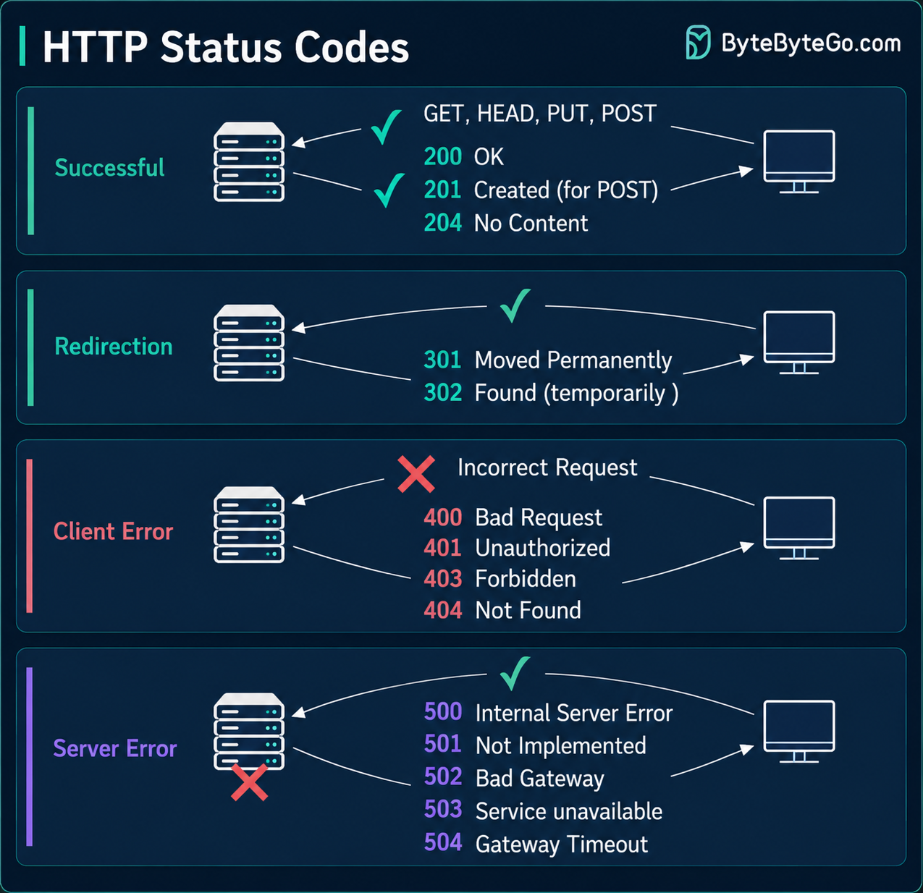
HTTP Status Codes
Three-digit codes that tell you exactly what happened

Slide 9
JSON — The Language of REST APIs
JavaScript Object Notation
// Sample API Response
JSON Data Types
{
String
"Hello World"
"id": 42,
"name": "Alice Chen",
Number
42 or 3.14
"role": "developer",
"active": true,
Boolean
true / false
"score": 98.6,
Array
["a","b","c"]
"tags": [
"rest", "api",
Object
{"key":"value"}
"backend"
],
Null
null
"address": {
"city": "Mumbai"
Why JSON over XML?
}
}
🪶 Lightweight — less overhead than XML
👀 Human-readable and easy to debug
⚡ Fast to parse — machines love it
🌍 Language-independent (JS, Python, Java…)

Slide 10
Authentication & Security
Protecting your API — security is non-negotiable
🔒
🔑
🎫
HTTPS / TLS
API Keys
JWT (JSON Web Token)
Secure communication between client and server.
Encrypts data in transit
Protects sensitive information
Always use HTTPS in production
Simple tokens passed in headers or query params. Easy to implement but limited — no expiry, hard to rotate, no user context. Best for server-to-server or low-sensitivity use cases.
Self-contained, stateless tokens with a payload of claims. Signed with a secret (HMAC) or private key (RSA). Three parts: Header.Payload.Signature — the industry favourite for REST APIs.
🔐
🛡️
⏱️
OAuth 2.0
Authorization (RBAC)
Rate Limiting
Delegated authorization framework — lets users grant third-party apps limited access to their data without sharing passwords. Used by Google, GitHub, Facebook, Stripe.
Authentication (who you are) ≠ Authorization (what you can do). Role-Based Access Control assigns permissions by role: admin can DELETE; viewer can only GET.
Limit requests per client per time window (e.g. 1000 req/hour). Protects against abuse, brute-force, and DDoS. Return 429 Too Many Requests with Retry-After header.

Slide 11
REST API Best Practices
Building production-grade, developer-friendly APIs
1
📌 Versioning from Day 1
2
📄 Pagination for Lists
Always version your API (v1, v2). Breaking changes go in a new version. Never break existing clients. Use: /api/v1/users → /api/v2/users
Never return thousands of records. Use page/limit or offset/limit. Always include total count and next/prev links in the response.
3
🔍 Filtering, Sorting, Search
4
💬 Consistent Error Responses
/products?category=electronics&sort=price&order=asc&search=phone — Use query params, never verbs in the path.
Always return structured errors: {"error": {"code": 404, "message": "User not found", "timestamp": "..."}}
5
📖 Documentation (OpenAPI)
6
🔄 HATEOAS & Discoverability
An undocumented API is an unusable API. Use Swagger/OpenAPI spec to generate interactive docs automatically from code annotations.
Include links to related resources in responses. Clients discover what they can do next without hardcoding URLs. (Hypermedia as the Engine of App State)
7
📊 Correct Status Codes
8
✅ Input Validation Always
Don't return 200 for errors. Don't use GET to modify data. Follow conventions — 201 for creates, 204 for deletes, 400 for bad input.
Never trust client data. Validate all inputs server-side. Sanitize to prevent SQL injection, XSS, and other injection attacks.

Slide 12
API Versioning Strategies
How to evolve your API without breaking clients
✓ Recommended
URI Path Versioning
Header Versioning
Query Param Versioning
GET /api/v1/users
GET /api/v2/users
GET /api/users
API-Version: 2
GET /api/users?version=2
✅ Pros
✅ Pros
✅ Pros
• Most visible and explicit
• Clean URLs
• Easy to test in browser
• Easy to test in browser
• Follows HTTP spec spirit
• Backward compatible
• Easy to route in gateway
❌ Cons
❌ Cons
❌ Cons
• Harder to test (need tools)
• Mixes versioning with data params
• URL is not 'pure' REST
• Less discoverable
• Can be cached incorrectly
• Duplicates resource addresses
💡 Rule: Never make breaking changes to an existing version. Create v2 and deprecate v1 gracefully with sunset headers.

Slide 13
Real-World REST APIs
Every tap, scroll and payment — powered by REST
🐦 Twitter / X API
🐙 GitHub API
💳 Stripe API
GET /2/tweets/123
Auth: Bearer token
POST /repos/user/repo/issues
Body: {"title":"Bug fix"}
POST /v1/payment_intents
Body: {"amount":999,...}
Used by: Analytics tools, bots, social dashboards, monitoring
Used by: CI/CD pipelines, project management, bots
Used by: E-commerce, SaaS billing, marketplaces
🗺️ Google Maps API
💬 WhatsApp Business
🌤️ OpenWeatherMap
GET /maps/api/geocode/json
?address=Mumbai&key=XXX
POST /v1/messages
Body: {"to":"+91...",
"text":"Order shipped"}
GET /data/2.5/weather
?q=Delhi&appid=KEY
Used by: Zomato, Ola, Uber, delivery apps
Used by: Banks, OTPs, delivery notifications
Used by: Weather apps, dashboards, IoT devices

Slide 14
API Developer Tools Ecosystem
The tools every API developer should know
Testing & Exploration
Documentation
Mocking & Simulation
Postman
Swagger UI / OpenAPI
JSONPlaceholder
Most popular GUI tool — build, test, document and share API requests. Supports environments, collections, automated tests.
Write an OpenAPI spec (YAML/JSON) and get free interactive docs, client SDK generation, and server stub generation.
Free public fake REST API. No signup. Perfect for demos and testing. typicode.com
Insomnia
Postman Collections
MockAPI.io
Lightweight alternative to Postman. Great for REST and GraphQL. Fast and keyboard-friendly.
Export your Postman collections as shareable API docs. Can be hosted on Postman's public workspace.
Create custom fake APIs with real endpoints, custom schemas and response delays.
Thunder Client
Readme.io
Mockoon
VS Code extension for quick API testing without leaving the editor. Lightweight and fast.
Developer hub platform for beautiful API documentation with live code samples and changelog.
Desktop tool to create mock REST APIs locally. Define routes, status codes, and response bodies.
curl
Command-line tool for API calls. Available everywhere — the ultimate fall-back. curl -X GET https://api.example.com/users

Slide 15
REST API Design Checklist
Before you ship — run through this list
URIs & Resources
HTTP Methods & Status
✓
URIs use nouns, not verbs
✓
GET never modifies data
✓
Collections are plural (/users not /user)
✓
POST returns 201 + new resource
✓
Lowercase, hyphens not underscores
✓
PUT/PATCH return 200 or 204
✓
Nested resources show relationships (/users/5/orders)
✓
DELETE returns 204 No Content
✓
Query params used for filtering/sorting/searching
✓
Correct 4xx and 5xx codes used
Security
Developer Experience
✓
All endpoints over HTTPS only
✓
API is versioned from day 1
✓
Authentication on protected routes
✓
Pagination on all list endpoints
✓
Authorization checks (user owns resource?)
✓
Consistent error response format
✓
Rate limiting implemented
✓
OpenAPI/Swagger docs generated
✓
Input validation on all fields
✓
README with getting-started guide

Slide 16
Thank You! 🙏
"APIs are the language computers use to talk to each other."
If u have Any Questions. Feel free to google it

